Slide 1
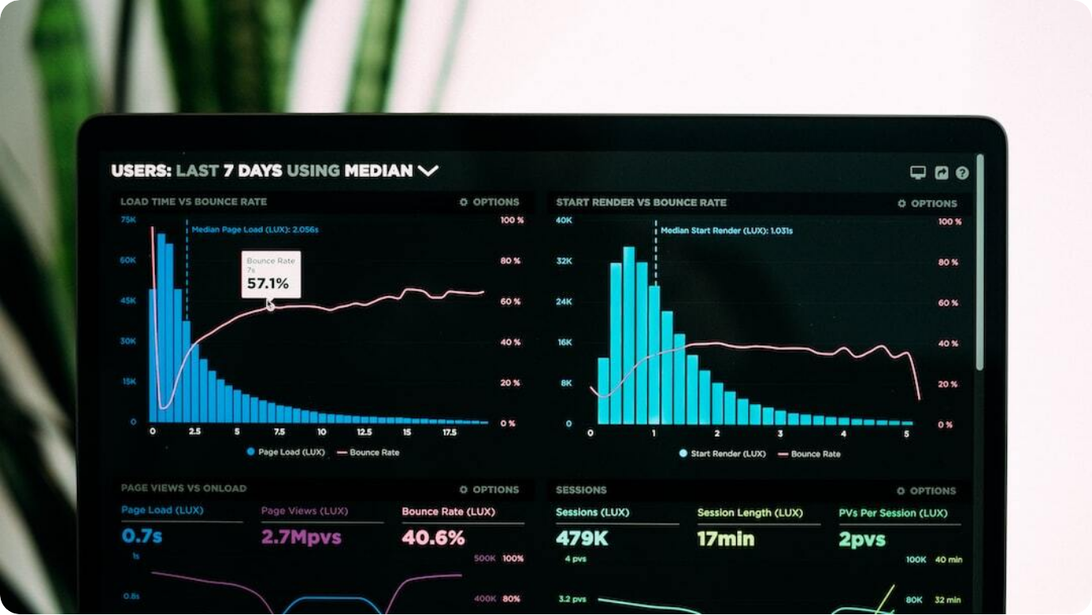
Welcome to the World of Data Analytics
Semester V – Diploma Level: This course is designed for fifth-semester diploma students, equipping them with foundational and advanced data analysis skills.
Course Code: 315326: The official identifier for the Data Analytics course, aligning it within the academic curriculum.
Branches: CM, CO, CW, IF, IH, SE, TE: The course is relevant for students across multiple engineering and computer-related branches.
"Transforming data into decisions": The course empowers students to convert raw data into actionable insights, a key skill in modern industries.
Photo by Luke Chesser on Unsplash
Notes:
Welcome to the fascinating realm of Data Analytics, where data isn't just numbers—it's the foundation of decisions. This course, offered in Semester V under the code 315326, serves as your gateway into the world where information becomes power. Designed for branches like CM, CO, CW, IF, IH, SE, and TE, this curriculum is highly interdisciplinary.
We'll explore how to transform raw data into meaningful insights, enabling smarter, evidence-based decisions in real time. Data analytics skills are now vital in every sector—from healthcare to entertainment, finance to marketing.
Throughout this course, you'll learn to tell stories with data, discover hidden patterns, and use tools that professionals rely on globally. So gear up for a journey that not only strengthens your technical skills but also sharpens your critical thinking. Let's begin your transformation into a data analyst.

Slide 2
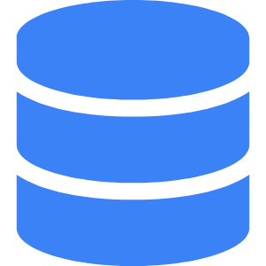
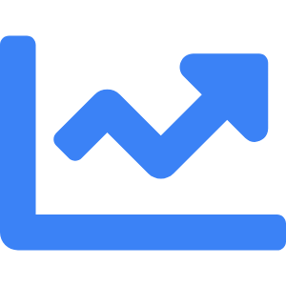

Why Is Data Analytics Important?
Everyday data: YouTube, Swiggy, Amazon, Netflix
These platforms generate vast amounts of user data, which is analyzed to personalize experiences and improve services.
Analytics makes sense of numbers
By applying statistical methods and tools, analytics converts raw data into comprehensible information.
Powers predictions, decisions, insights
Analytics supports forecasting trends, strategic decision-making, and uncovering actionable insights.
Notes:
Think of your everyday interactions—watching a show on Netflix, ordering dinner via Swiggy, shopping on Amazon, or browsing YouTube. Behind the scenes, data analytics is at work, shaping your experience. These platforms gather user behavior data at massive scales.
The beauty of data analytics lies in its ability to extract meaning from seemingly random numbers. Whether it's recommending your next video or forecasting product demand, analytics makes sense of complex datasets. It's the secret behind personalized experiences and efficient operations.
More than just interpretation, analytics drives action. Businesses use it to predict trends, governments use it for planning, and healthcare systems use it for diagnostics. In this course, you'll learn how to unlock such power from data.

Slide 3
What Will You Learn?
CO1: Concepts of analytics and data types: Learn fundamental principles of data analytics including classification of data and its importance.
CO2: Perform statistical techniques: Master core statistical tools such as regression analysis and hypothesis testing.
CO3: Work with Excel dashboards: Build and manipulate dashboards and pivot tables using Microsoft Excel.
CO4: Create and format charts: Design professional data charts to visually communicate insights.
CO5: Visualize data using Python: Use Python libraries like Matplotlib to generate informative visualizations.
Notes:
This course aims to empower you with practical, high-demand skills in data analytics. Starting with the basics, CO1 covers essential concepts and types of data you'll encounter. Knowing the data types is key to selecting the right analytical techniques.
CO2 equips you with statistical tools including regression and hypothesis testing, helping you understand relationships within data and validate conclusions. Then, CO3 takes you into Excel, one of the most widely-used tools in industry, teaching dashboard creation and pivot table manipulation.
CO4 and CO5 extend your capabilities into data visualization. You'll create compelling charts in Excel and also learn Python's powerful Matplotlib library to visualize data programmatically. These skills are foundational for any data analyst today.

Slide 4
Course Structure & Units
Introduction to Data Analytics: Overview of data analytics, scope, and key concepts.
Statistical Analysis: Covers descriptive and inferential statistics, including hypothesis testing.
Data Analytics using Excel: Hands-on training on Excel dashboards, pivot tables, and charting.
Visualization in Excel: Advanced chart formatting and storytelling with data using Excel.
Visualization in Python: Introduction to Python plotting libraries and creating rich data visuals.
Notes:
This slide breaks down the syllabus into five structured units. First, we begin with an Introduction to Data Analytics—this establishes your foundational understanding and shows how analytics is used in the real world. It's the launchpad for everything else in the course.
Next, you'll dive into Statistical Analysis, where you'll apply techniques like regression, probability, and hypothesis testing. These are core tools for making data-driven decisions. From there, we move into a hands-on zone: Excel-based analytics. You'll use this ubiquitous tool to build dashboards and analyze datasets efficiently.
The final two units cover visualization—first through Excel and then Python. You'll learn to use Excel’s rich visualization options to create impactful graphics. Then, we switch gears into programming with Python, learning tools like Matplotlib to build professional-grade data visuals. Together, these units give you a comprehensive toolkit for modern analytics.

Slide 5
Resources for Success
Excel Data Analysis – Jinjer Simon: Comprehensive guide to data analysis using Excel with real-world case examples.
Python Data Analytics – Fabio Nelli: Step-by-step approach to analytics using Python libraries like NumPy and Pandas.
Python Data Science Handbook – Jake VanderPlas: Covers core tools in the Python ecosystem for data science.
Data Analysis with Excel – A.J. Smalley: Focuses on mastering data processing and charting using Excel.
MindTap, NPTEL, FreeCodeCamp: Blended online learning resources offering video lectures, exercises, and certifications.
Notes:
To truly succeed in this course, access to quality resources is essential. Let's start with books. 'Excel Data Analysis' by Jinjer Simon and 'Data Analysis with Excel' by A.J. Smalley will give you the practical grounding you need to master Excel-based techniques.
For those keen on Python, 'Python Data Analytics' by Fabio Nelli and the 'Python Data Science Handbook' by Jake VanderPlas are top-tier guides. They take you through everything from basic operations to advanced visualizations using Matplotlib, Seaborn, and more.
Beyond books, we recommend leveraging online platforms like MindTap for structured assignments, NPTEL for academic lectures, and FreeCodeCamp for hands-on coding exercises. These tools ensure your learning is comprehensive, interactive, and up to industry standards.

Slide 6
How Will You Be Evaluated?
Theory (70 marks): Major written exam testing conceptual understanding and analytical skills.
Practical Internal (25) + External (25): Lab-based assessments by internal and external faculty.
SLA (10 marks) – Assignments, microprojects: Evaluation of short learning activities and application-based tasks.
Class Tests (2 × 30): Two internal tests measuring progress and readiness.
Continuous & Summative Assessment: Ongoing evaluations to ensure sustained learning and improvement.
Notes:
Assessment in this course is multifaceted to ensure all-round development. The core is the 70-mark theory paper, testing your understanding of concepts, statistics, and interpretation skills. Alongside, the practical component is split into internal (25 marks) and external (25 marks) evaluations—these reflect your ability to apply tools in real scenarios.
SLA, or Short Learning Activities, includes microprojects and assignments and adds another 10 marks. These activities are great opportunities to showcase creativity and understanding. Moreover, two 30-mark class tests will help track your progress and reinforce classroom learning.
Finally, continuous and summative assessments ensure that learning isn't just a one-time evaluation but a steady, guided process. This system encourages consistent effort, preparing you for both academic and industry expectations.

Slide 7

Tools You’ll Use in the Lab
Excel 365 – Dashboards, pivot tables: Used extensively for building dashboards, analyzing datasets, and creating reports.
Python – Matplotlib for charts: Python programming with visualization using Matplotlib and related libraries.
Windows 10+, 8GB RAM+, Core i5: Minimum system requirements to run analytics tools smoothly.
Jupyter Notebook / VS Code: Development environments for Python, supporting code, markdown, and visual output.
Photo by NordWood Themes on Unsplash
Notes:
Your analytics lab will simulate an industry-grade environment. The first essential tool is Microsoft Excel 365. You'll use it to create dynamic dashboards, manipulate large datasets, and summarize findings using pivot tables. Excel is an industry standard for quick, impactful data presentations.
Next, you'll dive into Python. Specifically, we'll use Matplotlib to generate a variety of charts. From bar plots to scatter plots, this library makes data speak visually. Python offers flexibility and automation that Excel can’t match, especially for repetitive tasks.
To support these tools, ensure your machine runs on Windows 10 or higher with at least 8GB of RAM and an Intel Core i5 processor. Your primary development environments will be Jupyter Notebook and Visual Studio Code—both are powerful, user-friendly interfaces that allow real-time code execution and interactive visualization.

Slide 8

Keys to Succeed
Attend practicals regularly: Hands-on labs are critical for mastering tools and techniques in analytics.
Apply concepts, don’t just memorize: Focus on understanding and applying analytical methods to real-world scenarios.
Complete SLA and microprojects: Short tasks and projects help reinforce concepts through practical execution.
Think like an analyst: Develop storytelling through data, critical thinking, and decision-making.
Photo by Isaac Smith on Unsplash
Notes:
Success in this course goes beyond just attending lectures—active participation in practicals is crucial. Each lab is a chance to engage directly with Excel and Python tools, gaining confidence in handling real data. Regular attendance ensures you stay aligned with hands-on expectations.
Equally important is conceptual application. Don’t fall into the trap of rote learning; analytics is about solving real problems. Your ability to apply what you learn to new situations will determine how well you succeed. This is where SLA and microprojects come in—they’re designed for practice, innovation, and reinforcement.
Finally, adopt the mindset of an analyst. This means learning to interpret data critically, extract insights, and tell compelling stories that support decisions. Think of yourself not just as a student—but as a problem solver. That mindset will set you apart.

Slide 9



Journey Ahead
Hands-on labs with live data
Practical sessions using real datasets to build analysis workflows.
Build dashboards, plots, and models
Combine Excel and Python to create visual and predictive tools.
Explore case studies
Analyze real business cases from platforms like Amazon and Swiggy.
Real-world projects
Capstone projects involving data storytelling and statistical insights.
Notes:
What lies ahead in this course is not just theory—but action. You'll work on hands-on labs using live datasets. This isn't sandbox data, but real, messy, meaningful data. It’s your opportunity to test hypotheses, build visuals, and interpret patterns in authentic contexts.
As you progress, you’ll create dashboards in Excel and plots in Python, culminating in simple predictive models. These aren’t just exercises—they mirror how analytics operates in modern businesses. You’ll also explore real case studies. How does Swiggy optimize delivery routes? How does Amazon suggest products? We'll uncover the analytics behind these questions.
Finally, you’ll engage in real-world projects that demand creativity, storytelling, and strategic thinking. These will challenge you to combine all the tools and knowledge you've acquired, preparing you for both academic and industry paths. Your data journey is just beginning.

